Slide 1
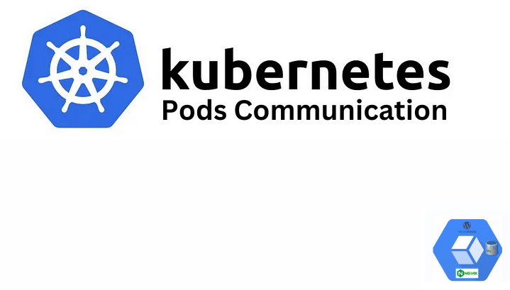

Slide 2
Scenario
You have a project divided in 3 parts frontend, backend and data base needed to be deployed on Kubernetes.

Slide 3
GitHub Repository
https://github.com/AlphaTab435/Kubernetes-Communication-Between-Pods

Slide 4
Docker Images
You can refer to following repository to create docker images and learning about communication between docker containers that will be needed before understanding current topic. https://github.com/AlphaTab435/Communication-between-Docker-containers I am going to use images that I already created in that exercise.

Slide 5
Tools
Kind (Using Kind (Kubernetes IN Docker) is a great way to create a local Kubernetes cluster using Docker containers)
Docker Desktop

Slide 6
For troubleshoot
Use kubecl logs podName for debugging

Slide 7
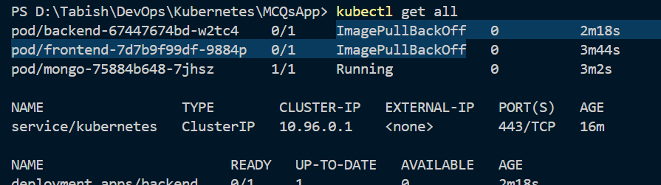
Error
If you are facing ImagePullBackOff like following image that might be due to you image is not public or you have not pushed it to docker hub

Slide 8
Methods
Manual creation through cli
Using deployment.yaml file

Slide 9
Manual creation through cli
kind create cluster // To create Kubernetes cluster
Now creating deployments using docker hub public images
kubectl create deployment mongo --image=mongo
kubectl create deployment frontend --image=muhammadtabish/mcqs_frontend_already_build
Note: Backend tightly depends on database so we will deploy backend on later stage

Slide 10
For pod communication we need services.
ClusterIP # Internal service for accessing from inside the cluster
NodePort # External service for accessing from outside the cluster
Note: --name while creating mongo service is important
If you have checked my Communication-between-Docker-containers repository link provided at start of document. You should check backend\src\constants.js

Slide 11
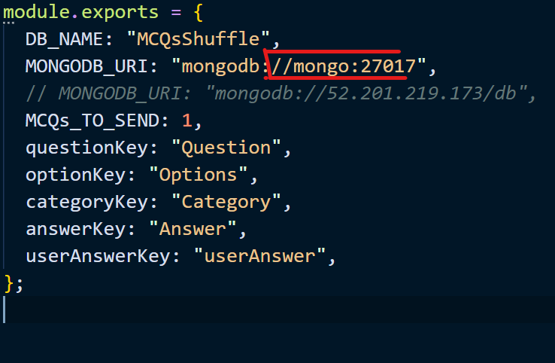
You should use same name for your database service

Slide 12
Now lets create services
kubectl expose deployment mongo --name=mongo --port= 27017 --type= ClusterIP
kubectl expose deployment frontend --name= frontend --port= 80 --type= NodePort
if above don’t work try using --target-port like used in below command
kubectl expose deployment mongo --type=ClusterIP --name=mongo --port=27017 --target-port=27017

Slide 13
Now we have to create backend deployment and service
kubectl create deployment backend --image=muhammadtabish/mcqs_backend
kubectl expose deployment backend --name= backend --port= 3000 --type= NodePort

Slide 14
Using deployment.yaml file
Instead of doing all above steps you can use deployment.yaml file that I have provided in github repository after creating cluster
kind create cluster // To create Kubernetes cluster
kubectl apply -f deployment.yaml // To apply yaml cofiguration

Slide 15
Port mapping
Use following on windows PowerShell for port mapping
Start-Job -ScriptBlock {kubectl port-forward service/backend 3000:3000}
Start-Job -ScriptBlock {kubectl port-forward service/frontend 80:80}
Use following to get, stop, remove a job
Get-Job
Stop-Job Id
Remove-Job Id

Slide 16
Feel free to delete resources after you have done testing. Commands will be similar to following
kubectl delete -f filename
kind delete cluster

